Slide 1


Slide 2
Detection Model of Moving Object in Low illumination:
SUPERVISOR NAME: Sir Rao Sohail Iqbal
STUDENT NAME: Mohammad Shoaib

Slide 3
Contents:
Introduction.
Evaluation of Dataset.
Related Work
Literature View.
Problem statements.
Methodology.

Slide 4
Introduction:
Today, many researchers are attracted to traﬃc because it has become a signiﬁcant problem in our life. With continuous urban road development and construction of highways, the accuracy of vehicle detection became more considerable between researchers in such weather condition low illumination. Automatic night vision systems for the moving vehicle assume that the input images have clear visibility under lane light. As the main task, vehicles detection aims to provide valuable information for multiple applications such as vehicle counting, vehicle speed measurement, automatic incident detection, and classify the vehicle.

Slide 5
Continue…
Various approaches have been proposed and applied to gather such traffic-related information in low illumination. Low illumination such as dust, low light, rain and fog in that conditions detection of images is a challenges task for a computer vision.

Slide 6
Continue…
A diversity of sensing manners have become available for vehicle detection. Video camera (Chen et al. 2014; Liang et al. 2015; Zhang et al. 2013), laser sensors (Mecocci and Micheli 2008), Wireless sensor network (Zhu et al. 2014), LIDAR (Cheng et al. 2014), inductive loop (Sheik Mohammed Ali et al. 2011), microwave radar (Horne et al. 2016; Hilleary and Omar 2012), magnetic sensors (Bugdol, Segiet, and Krecichwost 2014; Markevicius et al. 2016; Dong et al. 2018), ultrasonic sensors (Agarwal, Murali, and Chandramouli 2009; Kim and Eun 1998) and acoustics (Cevher, Chellappa, and McClellan 2009) that are in the market. Traditional methods used hardware (Celik and Kusetogullari 2010) such as inductive loop, radar, and laser to detect vehicles, but the disadvantages are high maintenance cost and being aﬀected by environmental factors (Wang et al. 2017). In contrast, video cameras are more useful for detection.

Slide 7
Continue…
Detecting of moving vehicle both a visual digital camera and a infrared camera. Infrared camera more suitable for night time due to its high resolution.
However there are many key issue related to vehicle detection at night using infrared camera.
Flat Cluttered Background.
Temperature polarity Changes.
Background Dynamic.

Slide 8
Flat Cluttered Background:
The infrared radiation signal must travel from the target to the camera sensor among adverse atmospheric particles and is attenuated due to scattering; the loss of radiation along the way produces a blurred flat region. In addition, with the thermal sensors, because of large variations in the surface, which includes hot and cool objects such as vehicles the foreground objects and the background scene become indistinguishable.

Slide 9
Temperature Polarity Changes:
Thermal temperature adjustment during the first appearance of a moving object in a video sequence causes illumination-type effects in the background model from the current video frame and, therefore, yields false classifications.

Slide 10
Background Dynamics:
Outdoor scenes are affected by movement in the background, e.g., due to waves or swaying tree leaves.
The simplest object detection strategy is to segment moving regions of interest from the static background.

Slide 11
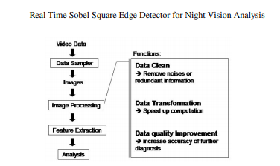

Slide 12
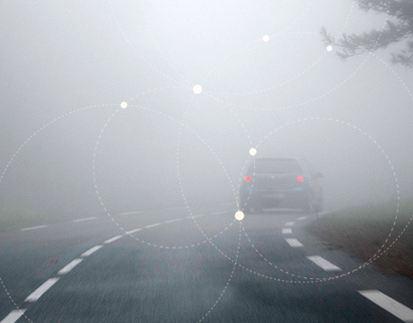

Slide 13
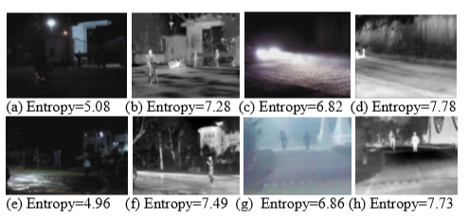

Slide 14
Related Work:
Jet propulsion laboratory used a computer vision method to detect vehicle for the first time.
Wang and Hu present a method of SVM for image classification. They use RGB and histogram as a low level feature in classifying image at night . This might wrongly classify nighttime image.
Staffer proposed a (GMM) Gaussian mixture model that typically against shadowy multimodal background region.
For improve low quality image L.shen proposed MSR.Net which use in CNN architecture .
Dbe.Net having powerful effect to clear the images in darkness and brightness.

Slide 15
Problem statements:
Road accidents have always been a major issue involving loss of life and property in low illumination. Many vehicle detection system have evolved which focus on solving this problem. Infrared camera for detection of moving vehicle are one of the broad solutions. They are built both for comfort and safety on roads. Many challenges occur during implementation for that problem. we are trying to solve here is the detection and classification of moving vehicle in low illumination. There has been many research works on vehicle detection till date. Our proposed work begins with identifying to detect the moving vehicle and classify them more accurately.

Slide 16
Methodology:
We proposed algorithms for detection and classification for traffic monitoring system in low illumination. For detection of vehicle using spatiotemporal feature and classify the vehicle using CNN.

